Slide 1

9 August 2023
Video Game Demo: The Sky is Falling
Rebecca Tafoya
PhD Graduate Student,
Department of Chemical Engineering

Slide 2


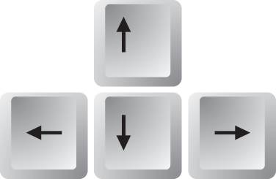
Basic Principle Behind My Game:

Slide 3
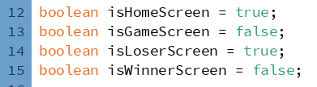
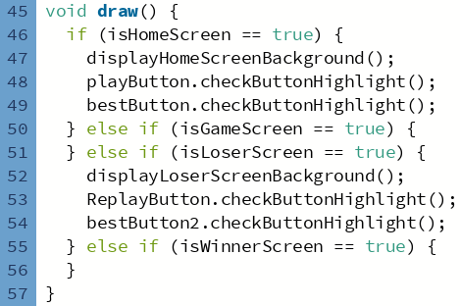
Other basic functionalities
Home Screen
Play Button
High Score Log Viewer Button
High Score Saver Screen
Data Entry (Name + Score)
Game Over Screen
Retry
High Score Log Viewer Button

Slide 4



Making Cute Buttons
PLAY
PLAY

